Slide 1
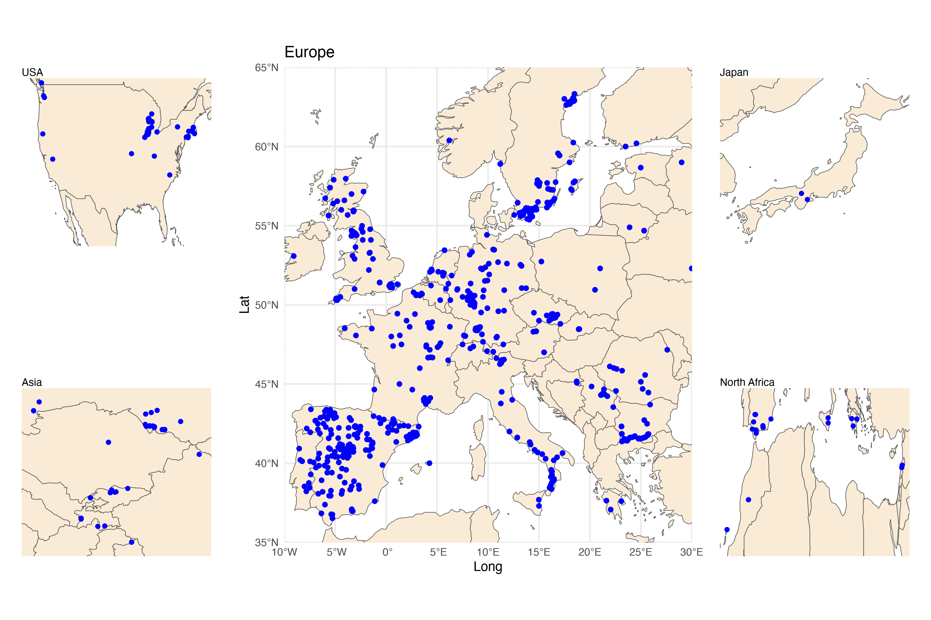
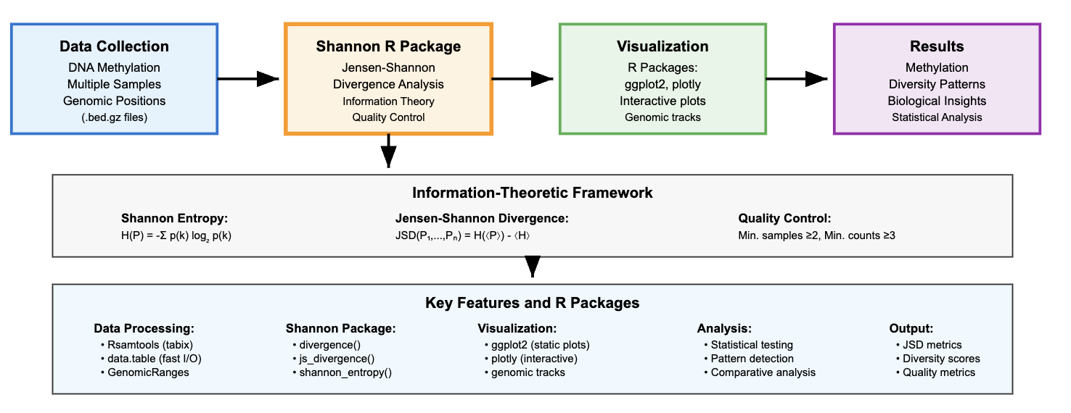

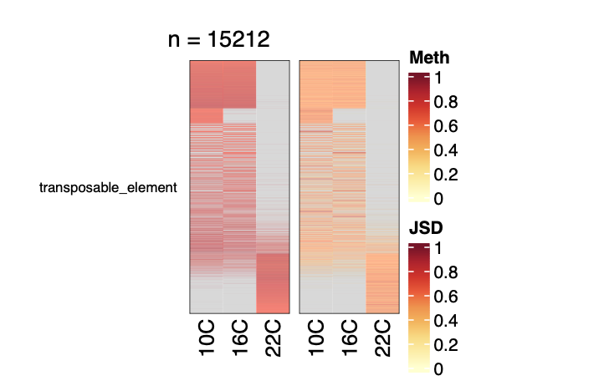
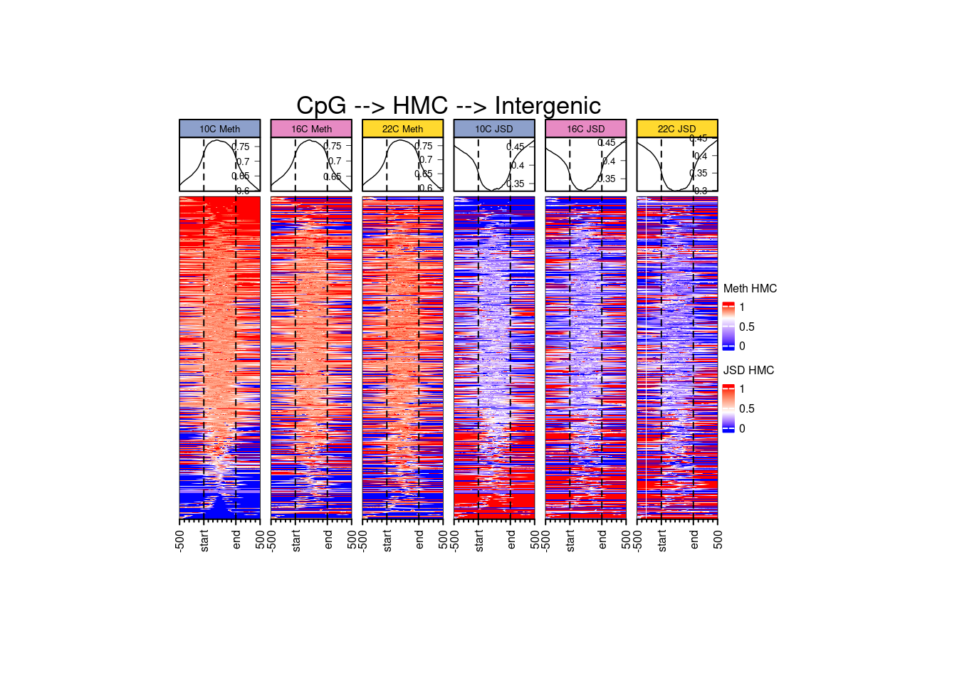
Fig 1.
MSC

Slide 2
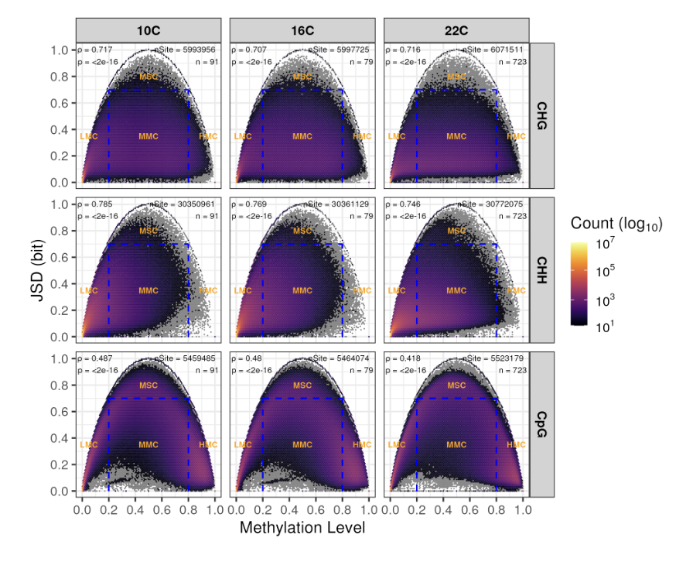
Fig 2.

Slide 3
Fig 3.

Slide 4
Fig 4. TE
CHG
CHH
CpG

Slide 5
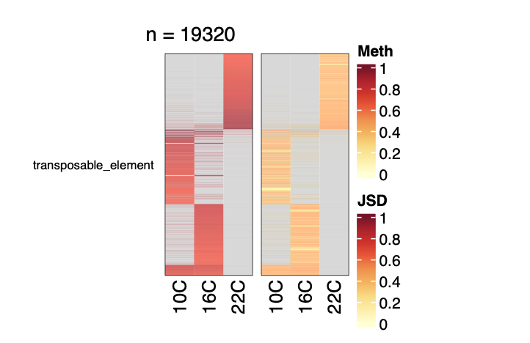
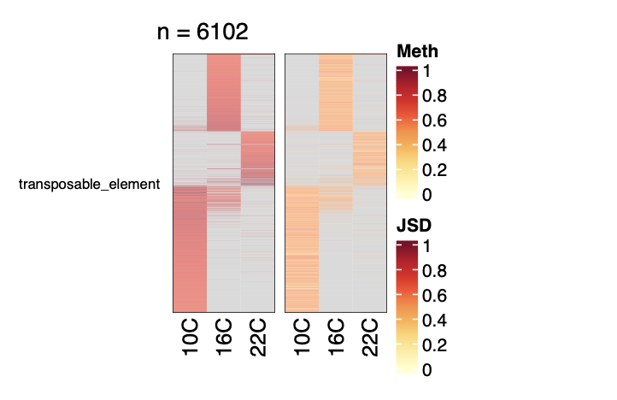
Fig 5.
CpG
CHH
CHG

Slide 6
Fig 6. Focus TE
CHG → CMT2
CHG → RdDM

Slide 7
CHH → CMT2
CHH → RdDM

Slide 8
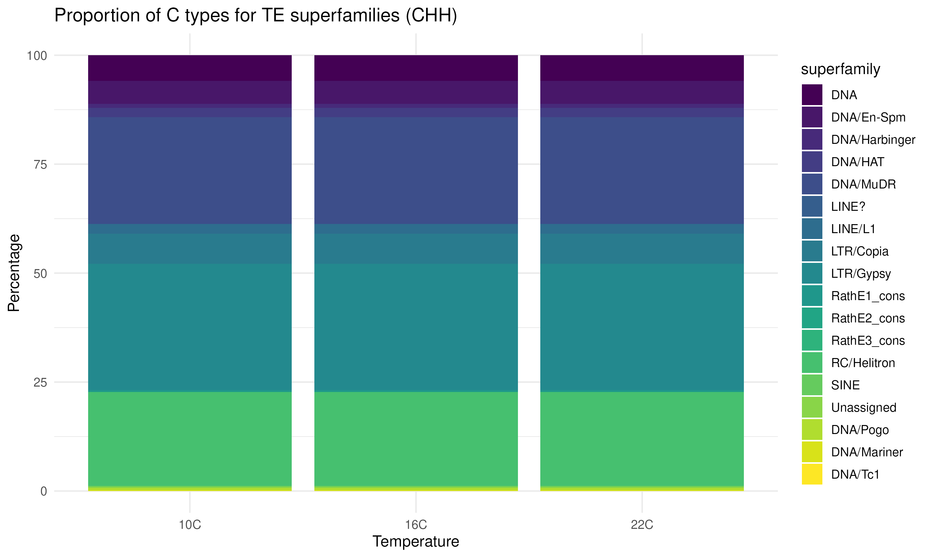
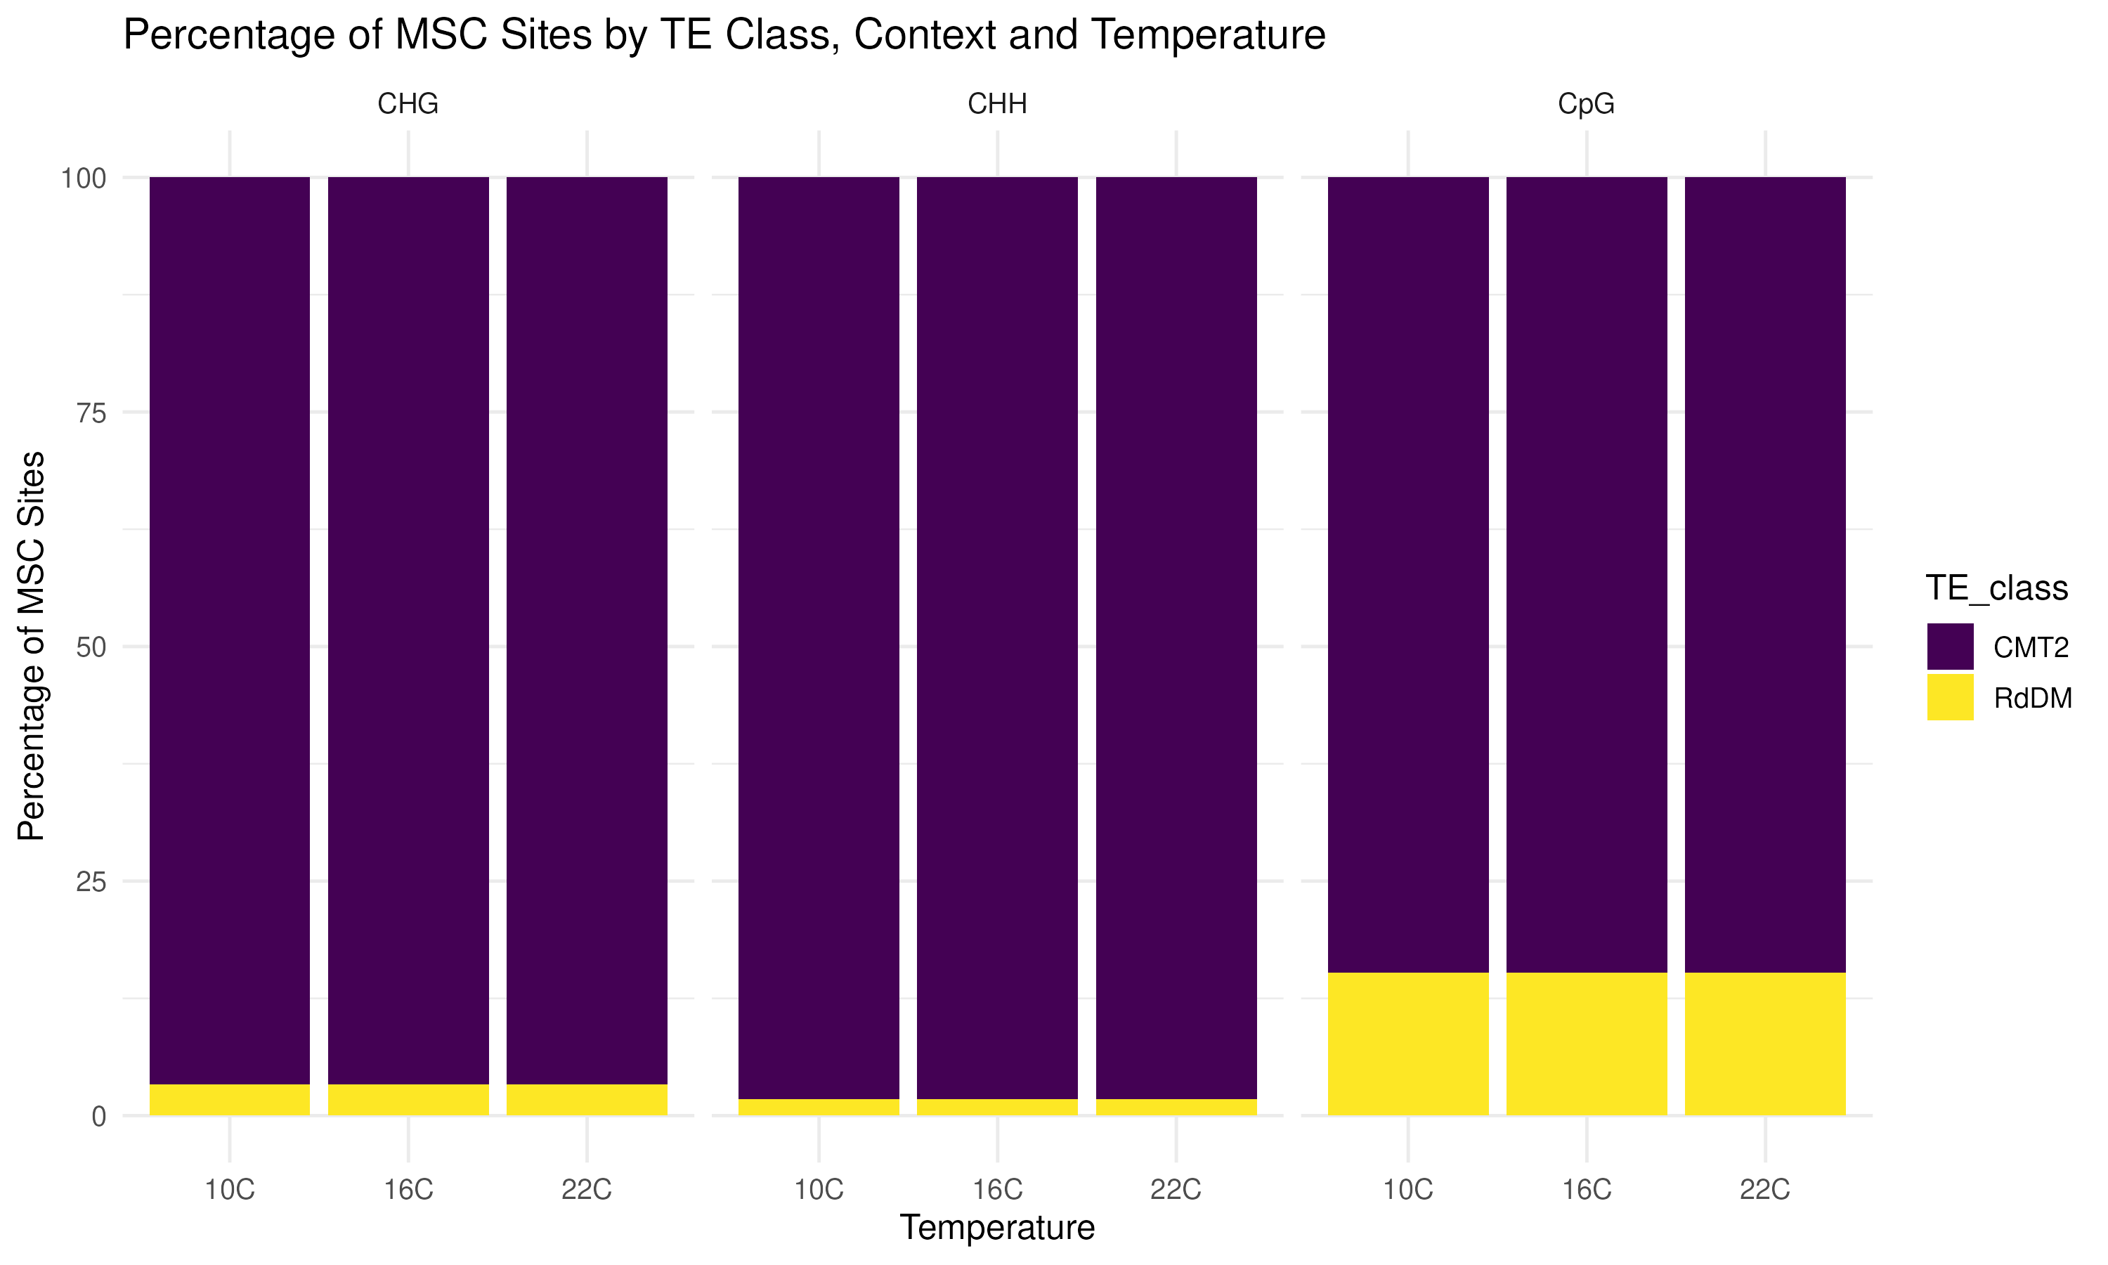
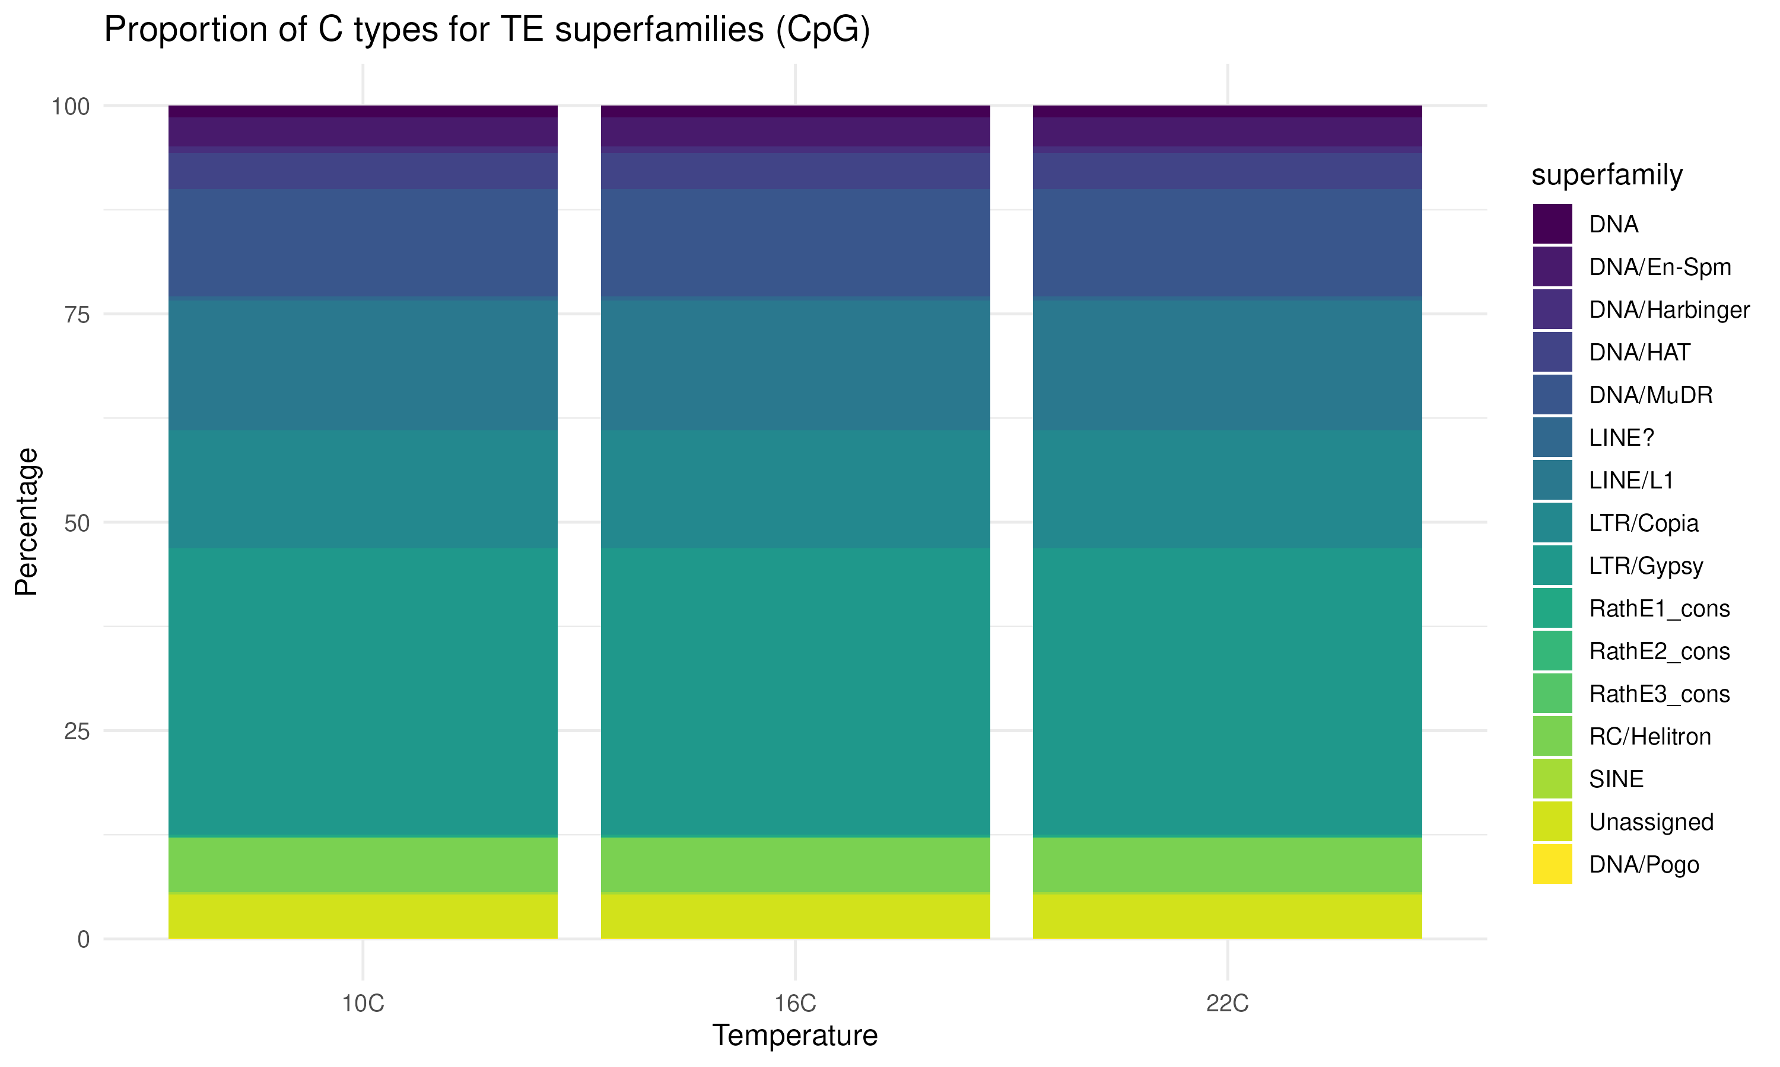
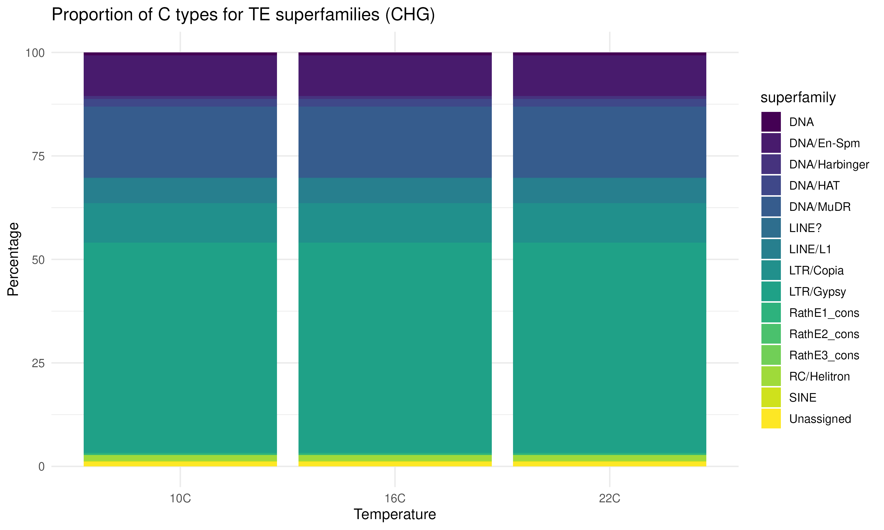
Fig 7. TE Superfamily

Slide 9
Fig 8. GO

Slide 10
